Slide 1
Subsurface Scattering
William Myers

Slide 2
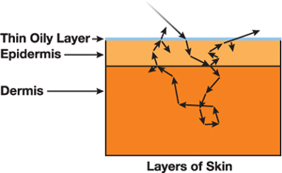
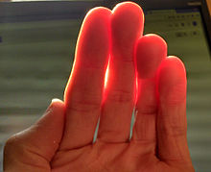
Background
Subsurface Scattering
Incoming light is reflected under the surface
Result: Color on a small area of a surface is, in part, a blend of surrounding colors
Translucent Lighting
Many organic materials (skin, for example) are not opaque
If the material is thin enough, light can be seen from behind
When rendering human skin, this light appears a red-orange because of blood and tissue
Figure 1
Figure 2
Figure 1
https://developer.nvidia.com/gpugems/GPUGems3/gpugems3_ch14.html
Figure 2
https://upload.wikimedia.org/wikipedia/commons/thumb/5/50/Skin_Subsurface_Scattering.jpg/220px-Skin_Subsurface_Scattering.jpg

Slide 3
Subsurface Scattering Method: Blur
1 px
1 px
1 px
1 px
1 px
1 px
Frag
[0.061, 0.0, 0.0]
[0.382, 0.5, 0.5]
[0.006, 0.0, 0.0]
[0.242, 0.25, 0.25]

Slide 4
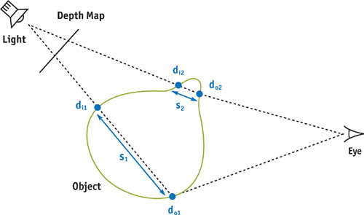
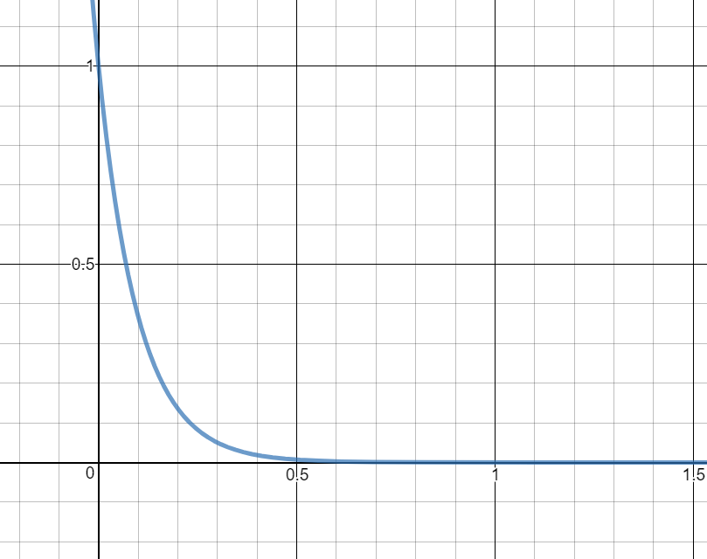

Translucent Light Simulation
$$e^{−10x}$$
Image source:
http://developer.download.nvidia.com/books/HTML/gpugems/gpugems_ch16.html

Slide 5
Render Process
Create Depth Map
Create Unwrapped Texture
Perform diffuse lighting
Use depth map to add translucent light
Blur unwrapped texture to simulate subsurface scattering
Draw scene
Use depth map to compute shadows
Compute specular lighting

Slide 6
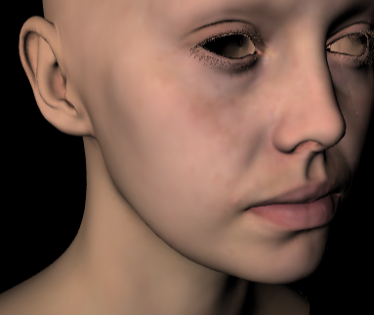
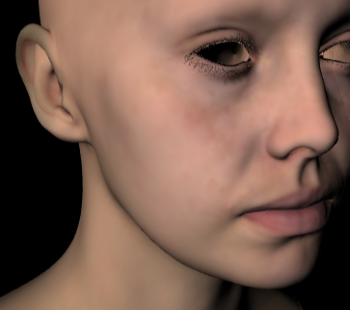
Rendering Samples
Without Blur
With Blur

Slide 7
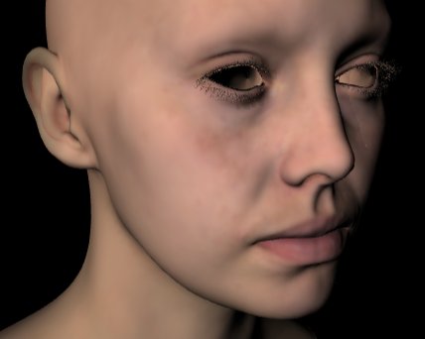
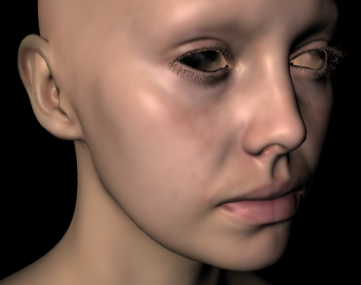
Rendering Samples
Without Specular Lighting
With Specular Lighting

Slide 8

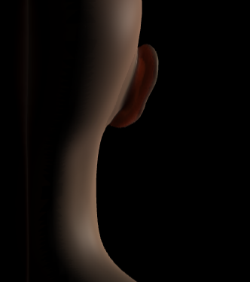
Rendering Samples
Without Translucent Lighting
With Translucent Lighting

